Slide 1



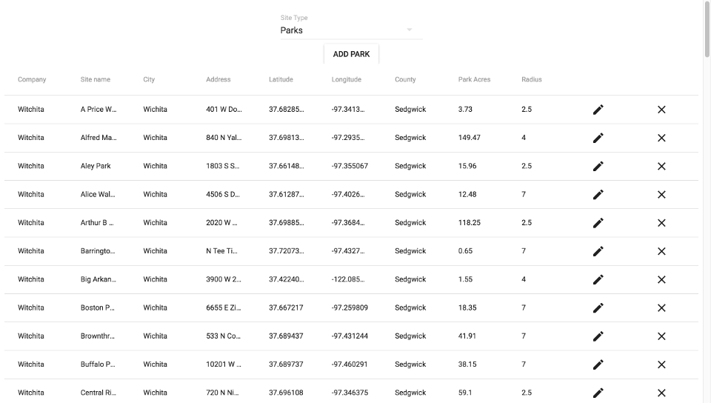



Smart City Applications
Phase 2
Benjamin Awad, Terrence Park, Skye Pekerti, Krithika Suresh, Elizabeth Trinh benjamin.awad@utdallas.edu, terrence.park@utdallas.edu, skye.pekerti@utdallas.edu,
krithika.suresh1@utdallas.edu, elizabeth.trinh@utdallas.edu
CS 4485 / Fall 2019
Department of Computer Science
Erik Jonsson School of Engineering & Computer Science
The University of Texas at Dallas
Richardson, TX 75080, USA
Abstract
Results
To accelerate smart city growth, Fujitsu Network Communications is working to install hardware sensors which monitor parking conditions, waste management, and more. This project features the development of mobile applications to help employees monitor and install these sensors and for users to make parking reservations.
The objective for Phase 2 is to create a backend and database and build an interface for the applications to communicate with the backend, as well as to fix any bugs from Phase 1.
Keywords: IoT, Smart Cities, UI/UX
User App
Admin App
Architecture
Android and iOS Applications
Apache Cordova
Ajax
jQuery Mobile
Moment.js
Backend and Database
Node.js
Sequelize
MySQL
Heroku
Admin
Website
Performance Metric
Weekly task completion rate: 92%
Some features were not completely implemented
Company mentor feedback: goals were met and pleased with work performed this semester
Functional expectations were met (completed functions do not have bugs or interruptions)
Impact
Smart City applications aim to futurize cities by using IoT technologies to monitor parking, waste, and more. Our work this semester was the next important step to completing this objective.
Before
UI design supported by basic hardcoded values
After
iOS support
Full backend implementation and integration with both mobile apps
Admin web app for direct data modification
Summary
Replaced hardcoded values with calls to the backend database
Improved usability and UI for installing devices and reserving parking spaces (e.g. navigation to parking spot, persistent login, user preferences, etc.)
Admin website to create users, bulk import sites and devices, easily view sites and devices

